Slide 1
Traps and Signals
Lesson #5

Slide 2

Return Codes

Slide 3

Return Codes
Child to Parent Process Communication
Used for Debugging and Error analysis
Zero = Successful child completion
Non-zero = Child failure codes
Failure Codes Determined by Application
  One = Default Failure Code

Slide 4
Return Codes
Pipelines return a SINGLE competion code for the entire Pipeline.
System Variable “$?” of the parent process
“exit” command sets the Return Code within the childs environment

Slide 5
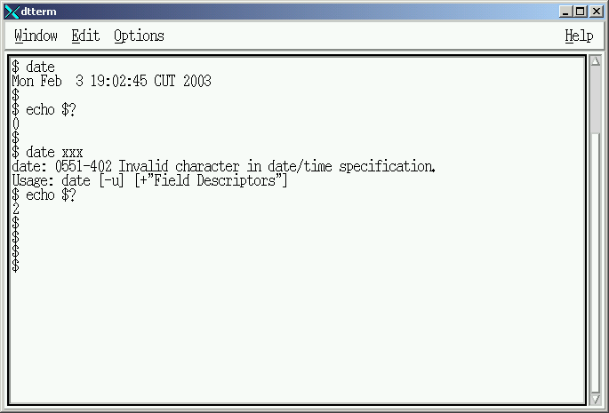


Example #1
Success
Failure

Slide 6
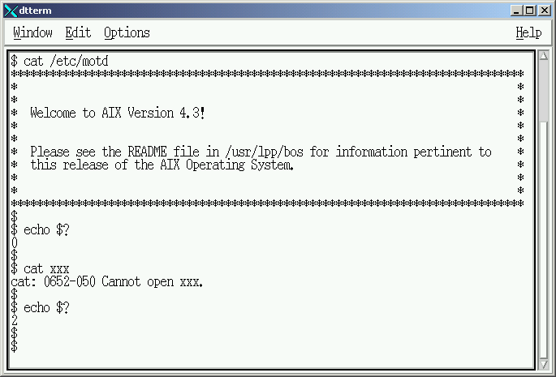
Example #2
Success
Failure

Slide 7
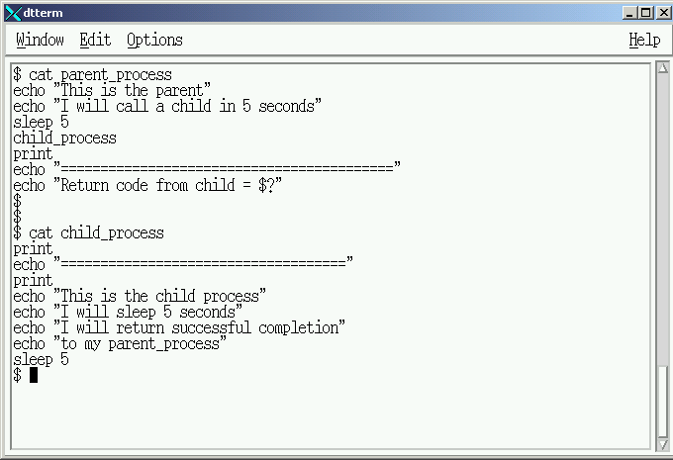
Create: Parent/Child Scripts
Return Code = 0
Return Code = 0

Slide 8
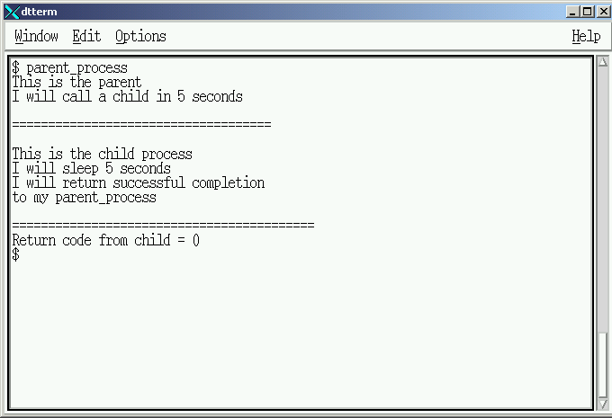
Execute: Parent/Child Scripts
Parent
Child
Parent

Slide 9
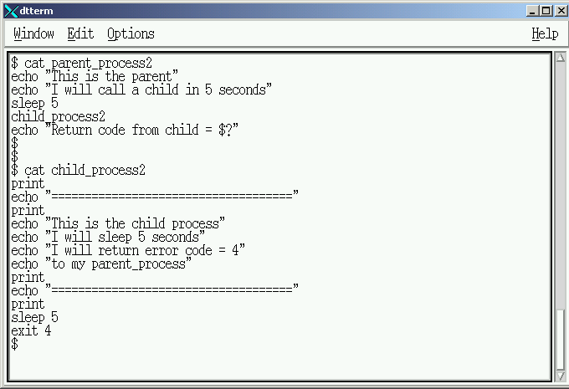
“exit <return code>” command
Return Code = 4
Return Code = 4

Slide 10
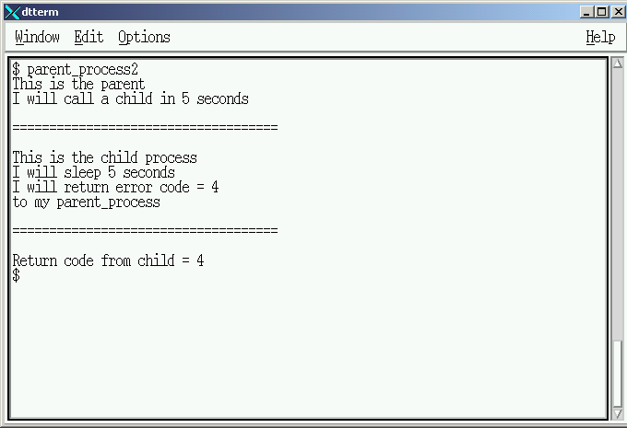
“exit <return code>” Execution
Parent
Child
Parent

Slide 11
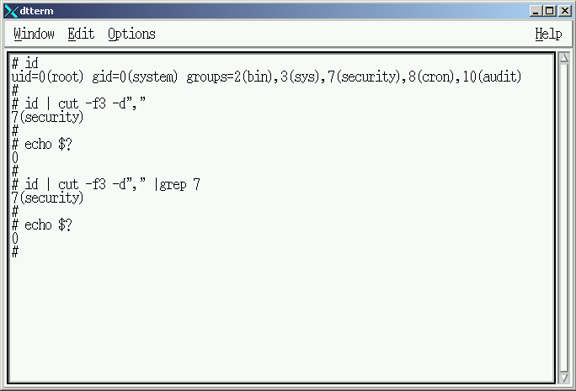
Successful Pipeline

Slide 12
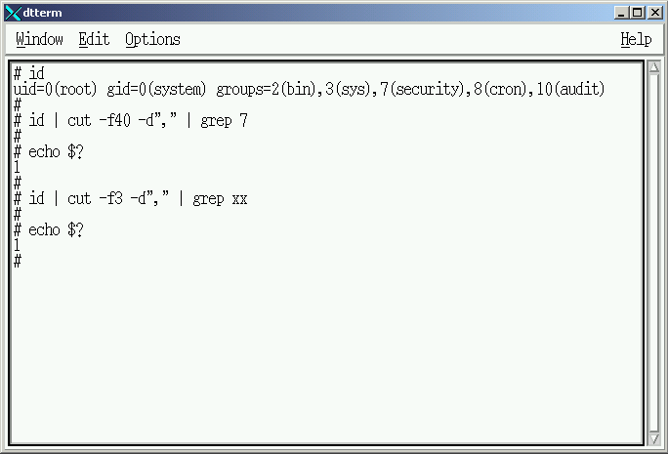
Pipeline Failure

Slide 13
Signals

Slide 14
Signals
Parent to Child Process Control
“kill” command
  Lists all defined signals
  Sends a signal to a controlled process (child)
  Formats: # kill -l
        # kill - <signal> <process-id>
“trap” command defines disposition of a received signal within the child process

Slide 15
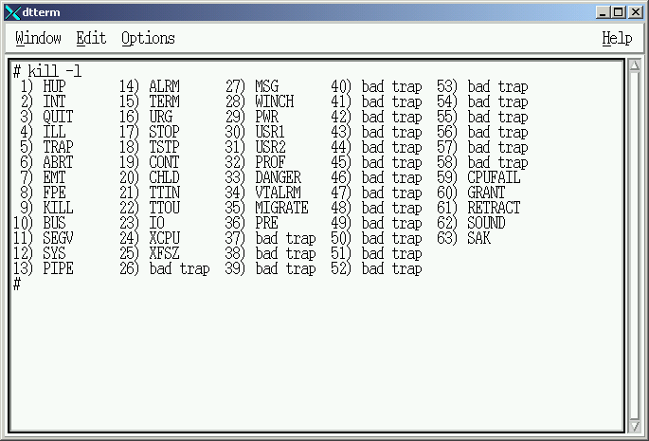
Trappable Interrupt Signals
Signals: INT, QUIT, TERM

Slide 16
Non-Trappable Interrupt Signal
Signals: KILL

Slide 17
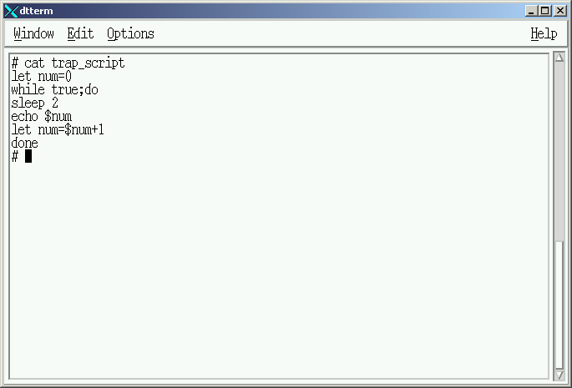
Create ‘trap_script’

Slide 18
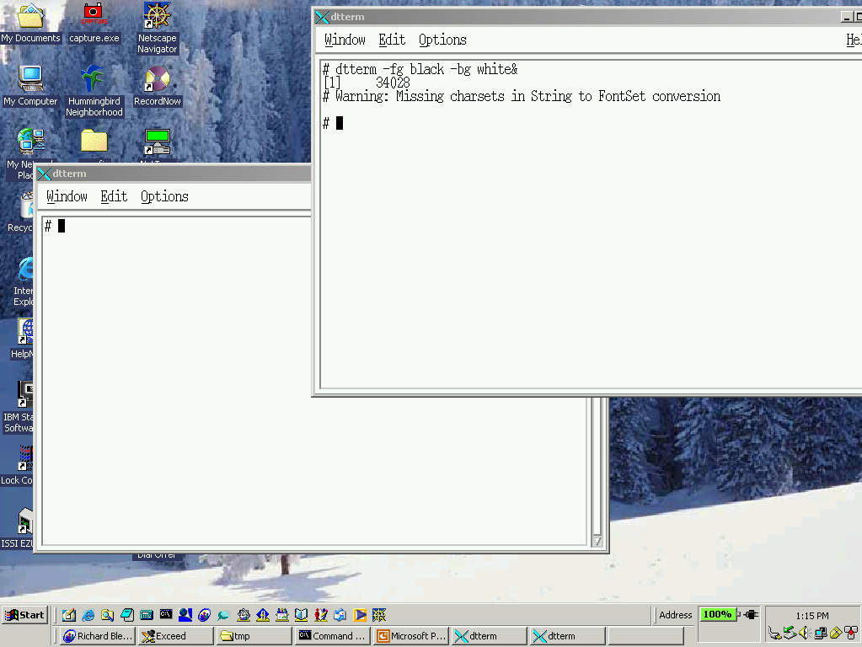
Open Process Control Window

Slide 19
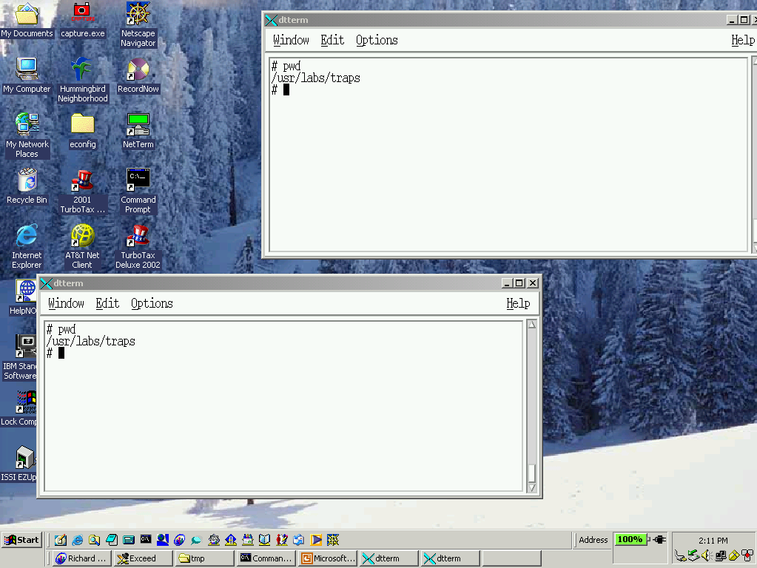
Verify Window Locations

Slide 20
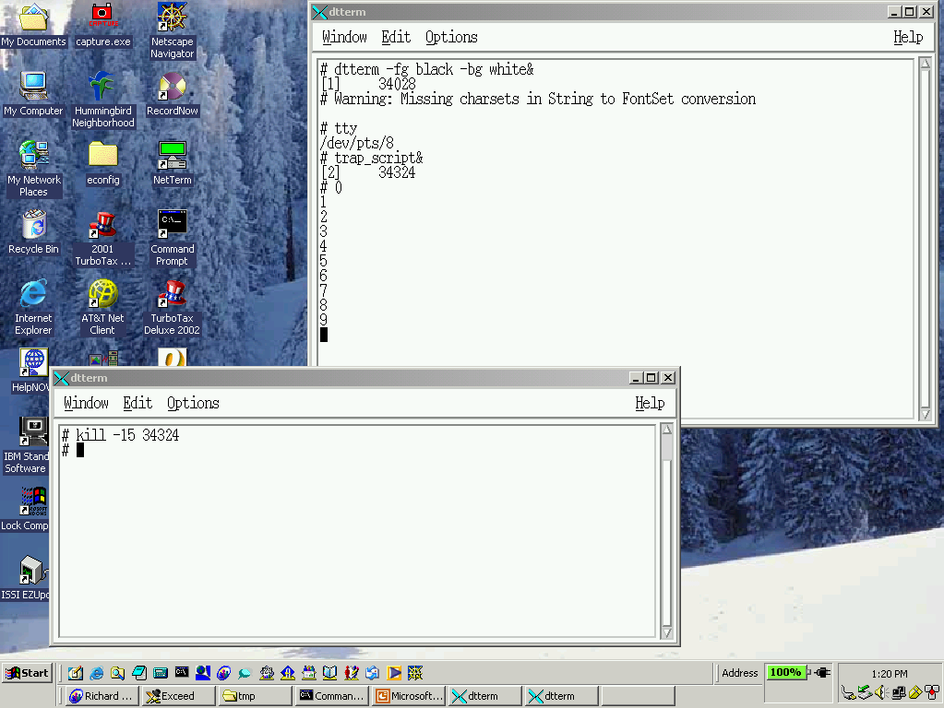
Termination Signal

Slide 21
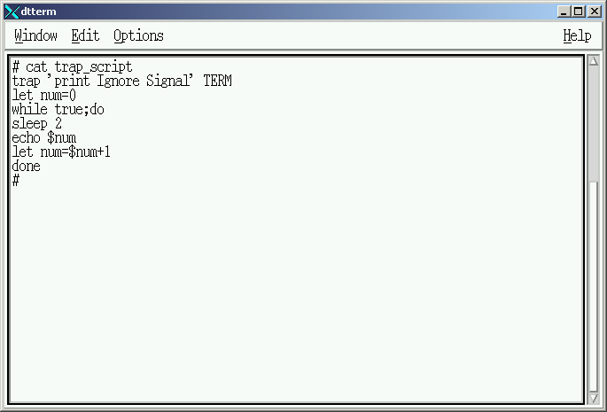
Ignoring Signals

Slide 22
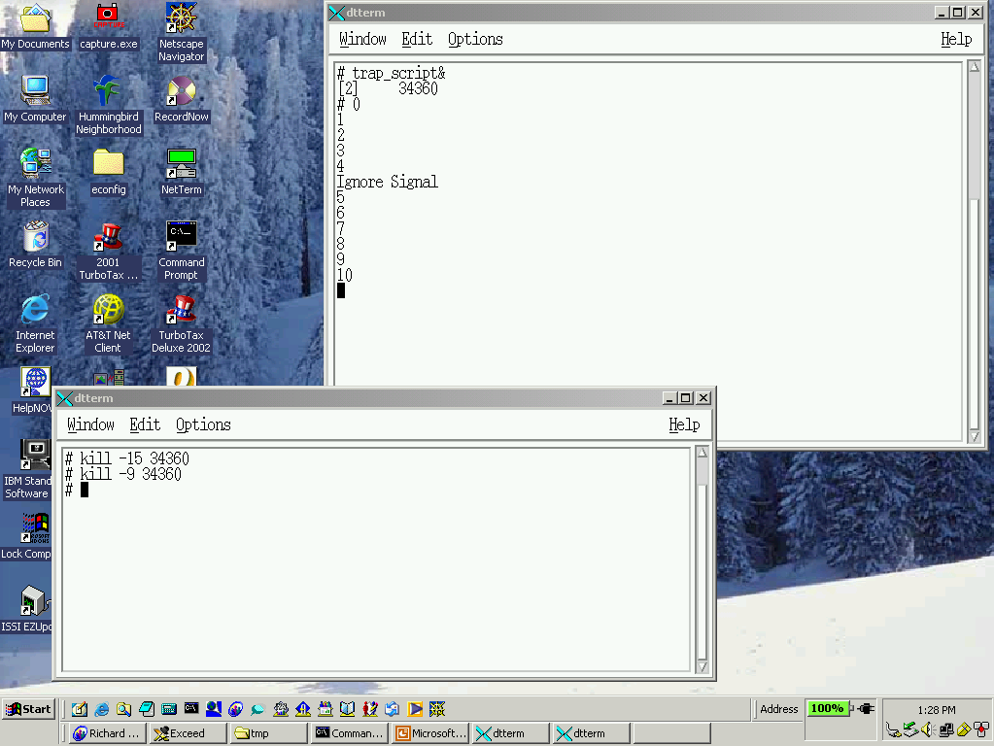
Sending ‘kill’ Signal

Slide 23
User Defined Signals
Signals: USR1 USR2

Slide 24
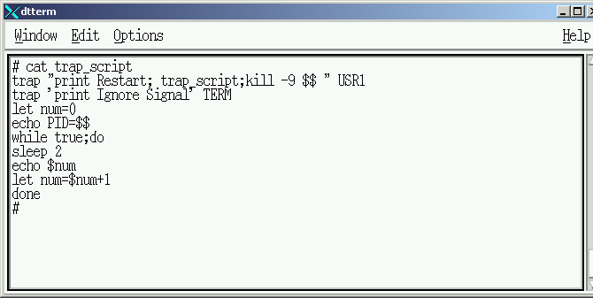
Modify ‘trap_script’

Slide 25
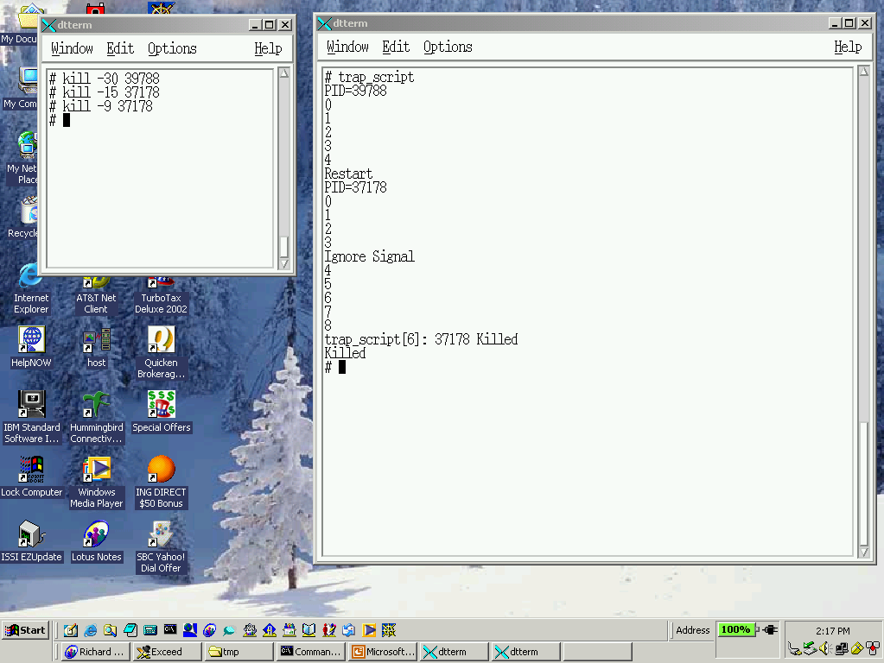
User Defined Trap

Slide 26
Execution Control Signals
Signals: STOP CONT

Slide 27
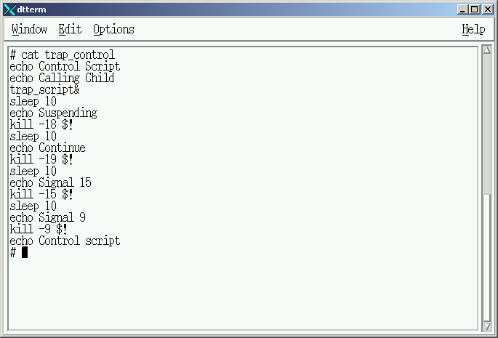
Create “trap_control”

Slide 28
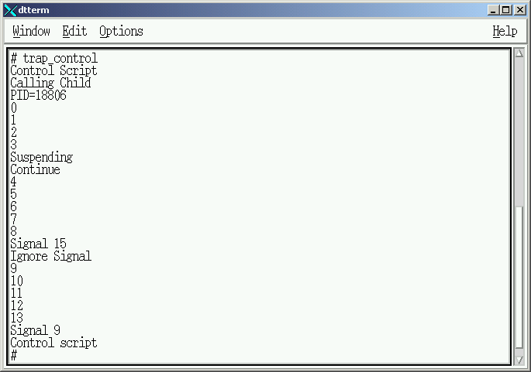
Controlling Processes

Slide 29
Lab #4

Slide 30
Lab 4 – General Instructions
Headings documentation requirements:
  Name
  Course
  Lab
  Date
Document command usage on first instance only

Slide 31
Lab 4 – General Instructions
Shellscripts MUST be completed ontime
Assigned Due Date:
  Run shellscripts for instructor
  Turn-in hardcopy of all shellscripts

Slide 32
Main Menu Modifications
Modify the Menu System created in Lab 2
  Menu Item selection number “3 (three)”.
  Menu Item Description “Launch Lab 4”
Add a Main Menu Heading line
  Centered two lines above the menu
  Identify the “Main Menu” and “PID #”

Slide 33
Main Menu Modifications
Trap the following signals by NAME and set “IGNORE” by doing NOTHING when the signal is received.
  Interrupt signal number 2
  Quit signal number 3
  Terminate signal number 15
  Kill signal number 9

Slide 34
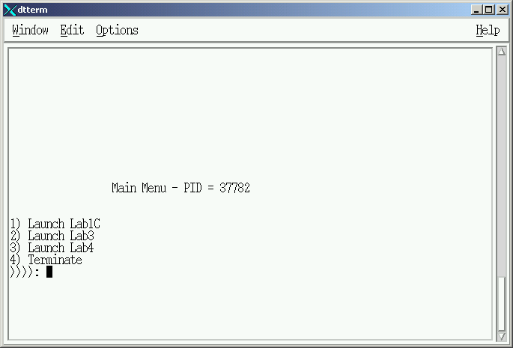
Main Menu Example

Slide 35
Launch Lab 4 – Sub Menu #1
Menu selection performs the following:
  Dynamically change the foreground and background screen colors.
    Only colors 0 – 7 will be selected
    Ensure foreground and background colors are different
  Displays Sub Menu #1 in the same screen position as the Main Menu

Slide 36
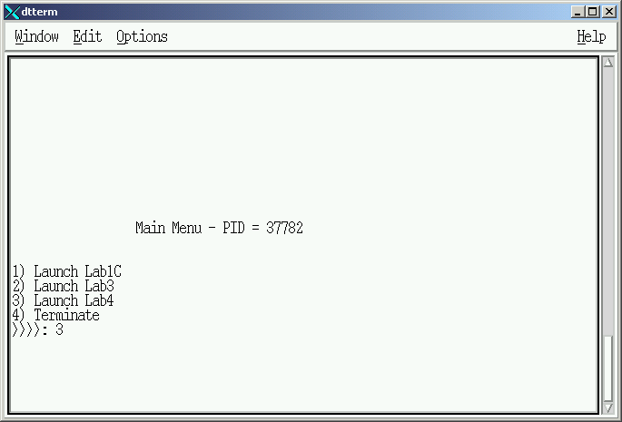
Sub Menu #1 - Access

Slide 37
Lab 4 – Sub Menu #1
Sub Menu contains 4 (four) Selection Items plus (default):
  Item 1 = “System Information”
  Item 2 = “ Future Lab “
  Item 3 = “ Future Lab “
  Item 4 = “Return”
  (Default)

Slide 38
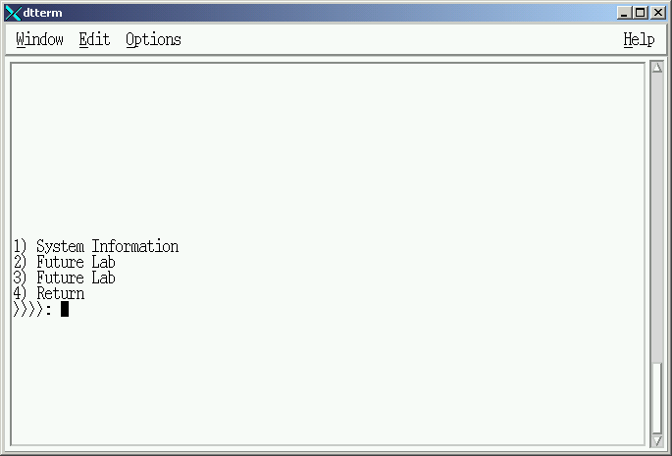
Sub Menu #1

Slide 39
Lab 4 – Sub Menu #1
Selection of “Items 2 & 3”
  Item Labels = “Future Labs”
  Action:
    Clear the screen
    Redisplay Sub Menu #1.

Slide 40
Lab 4 – Sub Menu #1
Selection of “Item 4”
  Item Labels = “Return”
  Action:
    Clear the screen
    Redisplay Main Menu

Slide 41
Lab 4 – Sub Menu #1
Selection of “Item 1”
  Item Labels = “System Information”
  Action:
    Clear the screen
    Display Sub Menu #2

Slide 42
Lab 4 – Sub Menu #1
Selection of “Item (default)”
  Action:
    Set foreground and background to fixed colors
    Clear the screen
    Flash an ERROR MESSAGE in the middle of the screen for 5 seconds
    Return to sub menu #1

Slide 43
Launch Lab 4 – Sub Menu #2
Menu selection performs the following:
  Dynamically change the foreground and background screen colors.
    Only colors 0 – 7 will be selected
    Ensure foreground and background colors are different
  Displays Sub Menu #2 in the same screen position as the Main Menu and Sub Menu #1

Slide 44
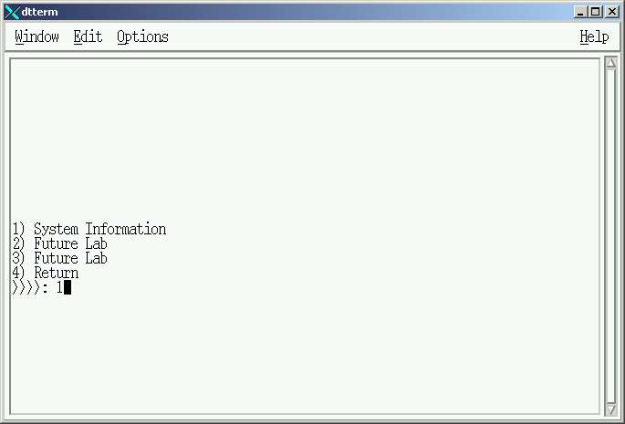
Sub Menu #2 - Access

Slide 45
Lab 4 – Sub Menu #2
Sub Menu contains 4 (four) Selection Items plue default:
  Item 1 = “Memory”
  Item 2 = “Paging Information“
  Item 3 = “Disk Information“
  Item 4 = “Return”
  Item = (Default)

Slide 46
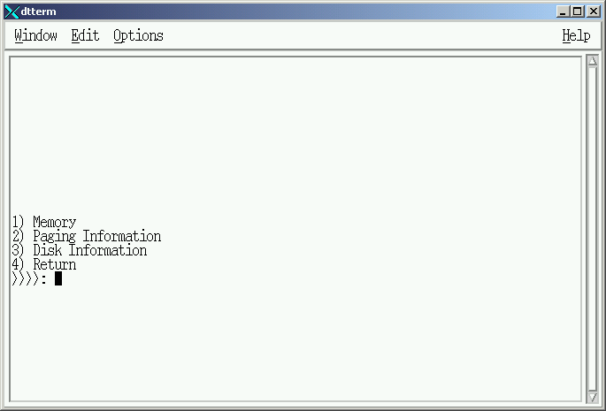
Sub Menu #2

Slide 47
Lab 4 – Sub Menu #2
Selection of “Item 1”
  Item Label = “Memory”
  Action:
    Use “memory_template” on next foil making indicated additions.
    Return to sub-menu #2

Slide 48
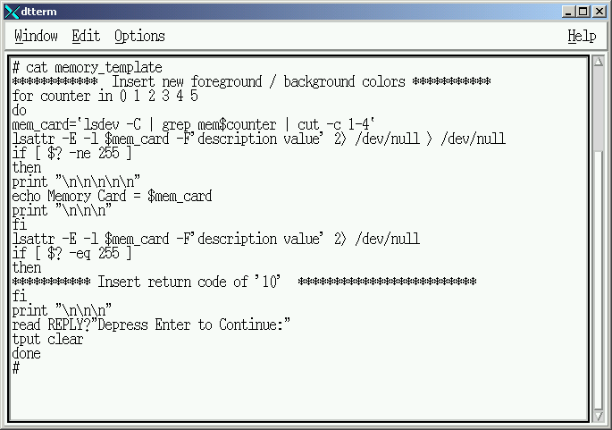
Memory Information Template
Insert return code of ’10’

Slide 49
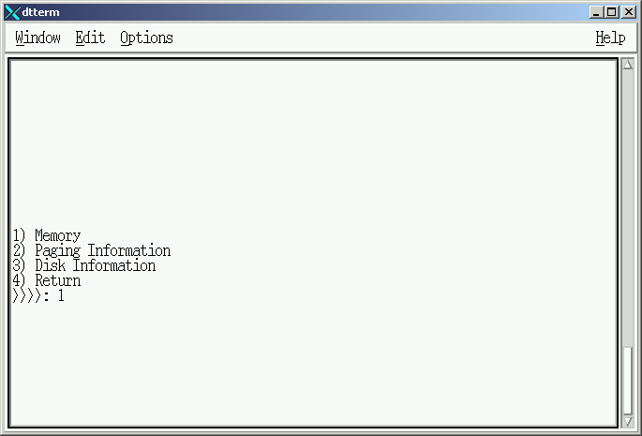
Memory Information

Slide 50
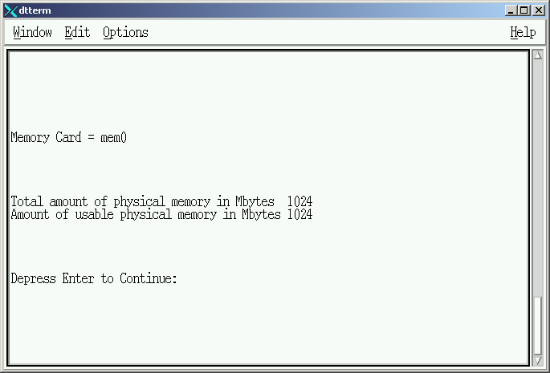
Memory Information

Slide 51
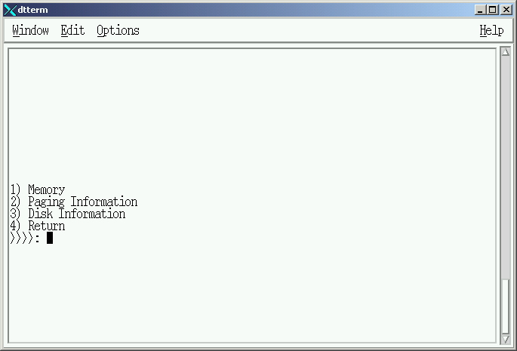
Memory Information

Slide 52
Lab 4 – Sub Menu #2
Selection of “Item 2”
  Item Label = “Paging Information”
  Action:
    Use “paging_template” on next foil making indicated additions.
    Return to sub-menu #2

Slide 53
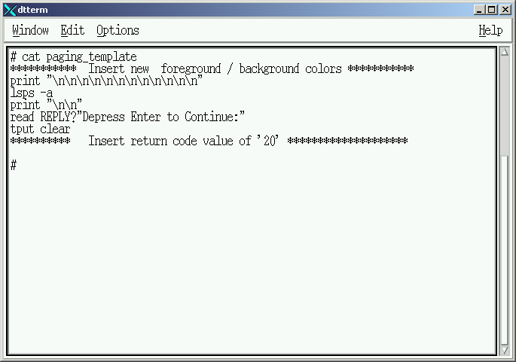
Paging Information Template

Slide 54
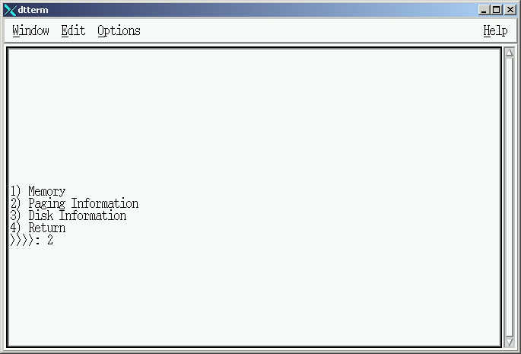
Paging Information

Slide 55
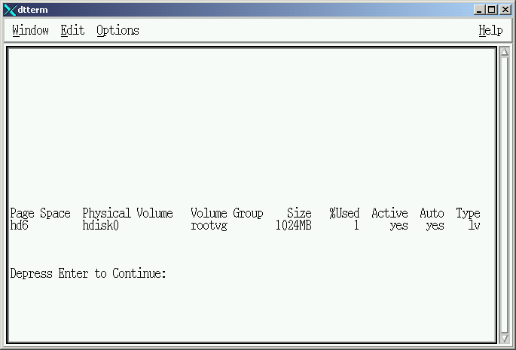
Paging Information

Slide 56
Lab 4 – Sub Menu #2
Selection of “Item 3”
  Item Label = “Disk Information”
  Action:
    Use “disk_template” on next foil making indicated additions.
    Return to sub-menu #2

Slide 57
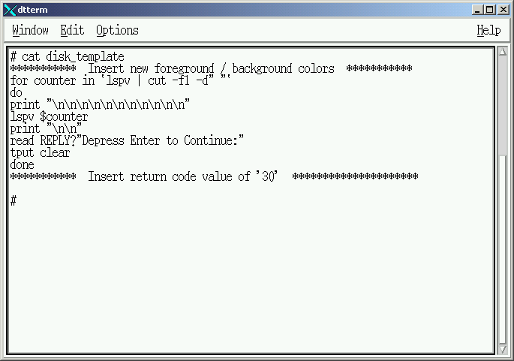
Disk Information Template

Slide 58
Sub Menu #2 – Return Codes
Perform AFTER menu items 1,2 & 3 complete and return to sub menu #2.
Action:
    Set foreground and background to fixed colors
    Clear the screen
    Flash a MESSAGE in the middle of the screen for 5 seconds
    Message selection based on the Return Code sent by the termination of items 1, 2 or 3.
      Example: Menu Selection #1 (Memory Information) terminates with a return code = 10. The parent process (sub menu #2) will take that return code and display “Memory Information Report Completed”.
    Return to sub menu #2

Slide 59
Traps and Signals
Lesson Completed
Lab #4 – Review Only

